Slide 1
This UI kit uses Helvetica Neue and Open Sans Fonts
(Available for download online)

Slide 2
LOGIN AND SIGNUP

Slide 3
AT&T M-Cell
8:01 AM
92%
LOG IN
Log In with Facebook
or
Username
Password
LOG IN
Forgot your password?

Slide 4
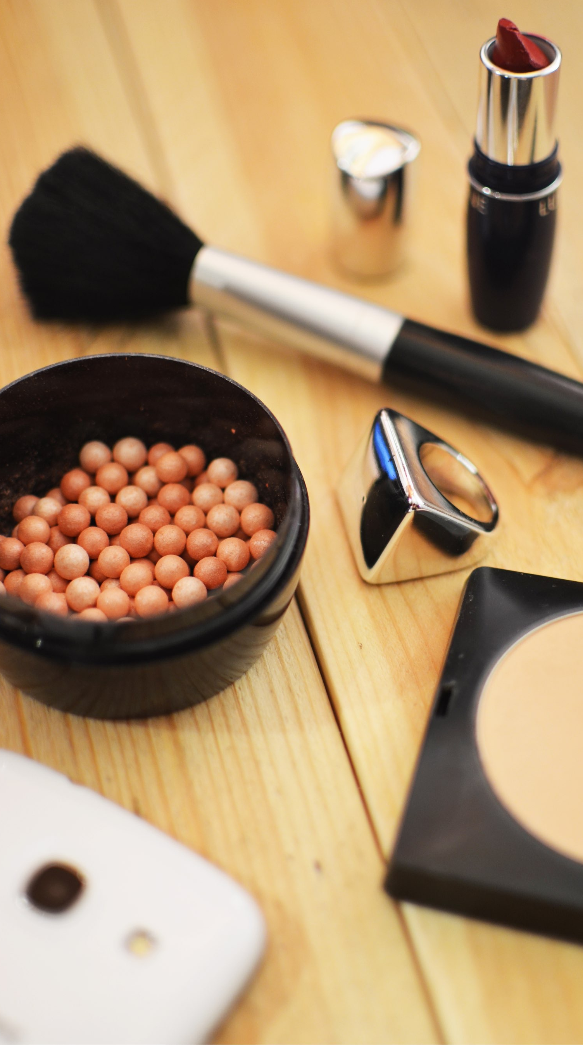
KEYNOTOPIA
Discover your next great project
Continue with Facebook
Sign up with Email
Already have an account? Sign In
View Our Terms
Skip

Slide 5
AT&T M-Cell
8:01 AM
92%
Back
Sign In
Done
Sign Up
Sign In
Email
you@domain.com
Password
at least 6 characters
Forgot Password

Slide 6
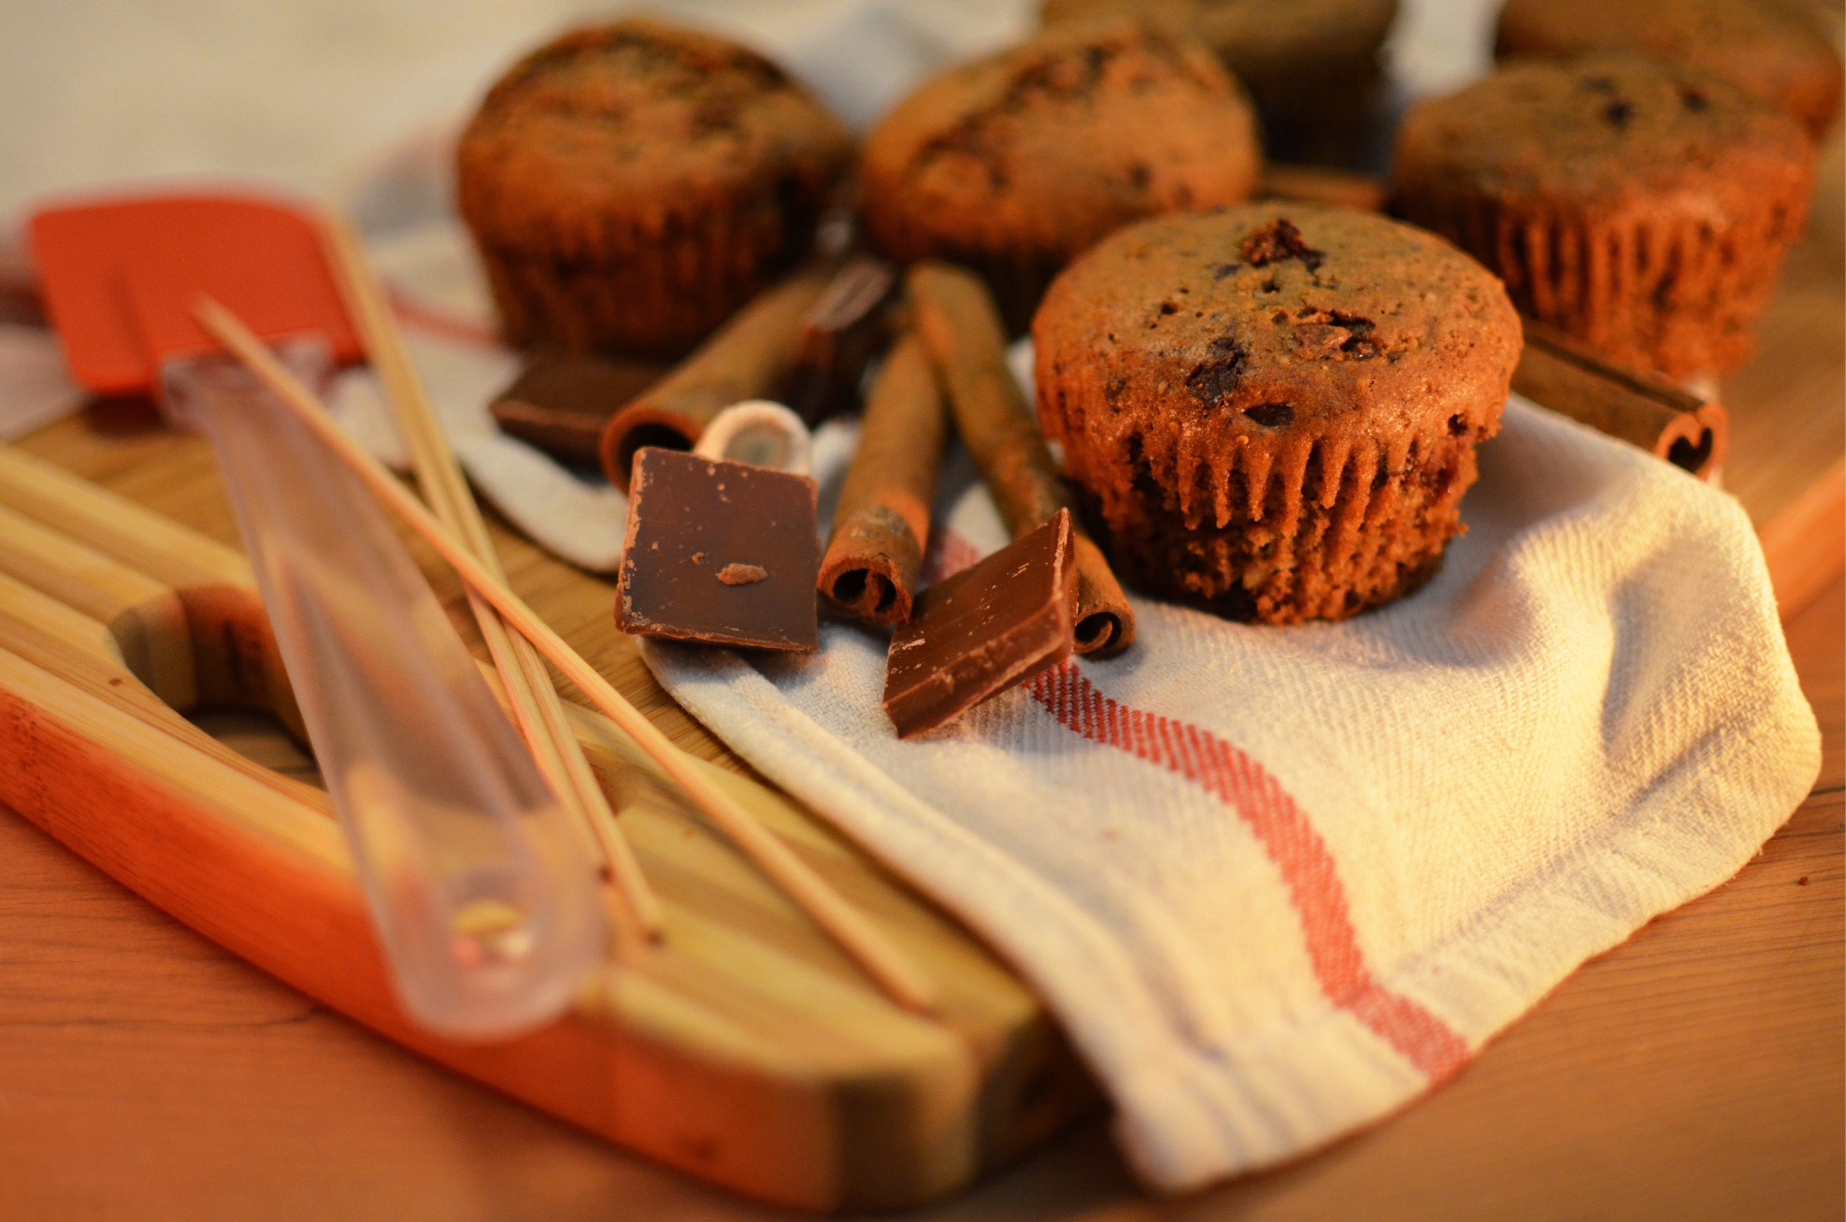
AT&T M-Cell
8:01 AM
92%
Join Now
Sign In
Email
Password
Show
forgot password?
SIGN IN

Slide 7
AT&T M-Cell
8:01 AM
92%
Cancel
Sign In
Sign in with Facebook
Sign in with Google+
MAIL
Your email address
PASSWORD
Your password
Keynotopia Terms of Use, Cookie Policy and Privacy Policy

Slide 8
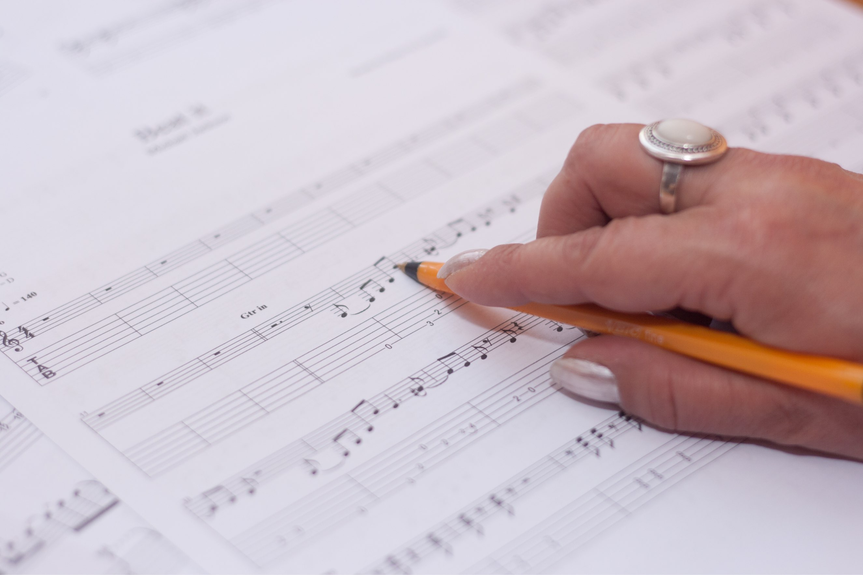
Email
Password
Forgot?
Log In
Q
W
E
R
T
Y
U
I
O
P
A
S
D
F
G
H
J
K
L
Z
X
C
V
B
N
M
123
space
@
.
Next

Slide 9
AT&T M-Cell
8:01 AM
92%
Log in with your Keynotopia account
Email
Password
Cancel
Log in
Forgot your password?
Q
W
E
R
T
Y
U
I
O
P
A
S
D
F
G
H
J
K
L
Z
X
C
V
B
N
M
123
space
@
.
Next

Slide 10
ECOMMERCE

Slide 11


AT&T
9:29 AM
41%
````
Paris, FR
Saint Tropez
$
110
14
Chateau Messardiere - Saint Tropez:150m
17
Private Room
Hosted by Jacques
Instant Book

Slide 12

AT&T M-Cell
8:01 AM
92%
1
1/13
Ritz hotel
Hotel Class: 4.0
5 Reviews
From
$318
Book Now

Slide 13
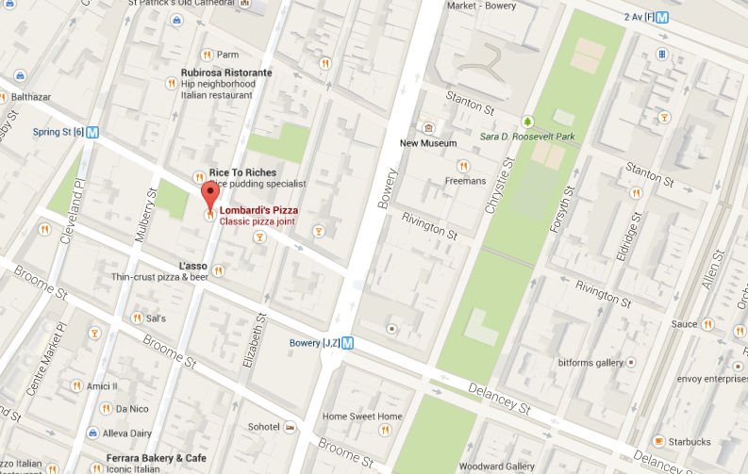
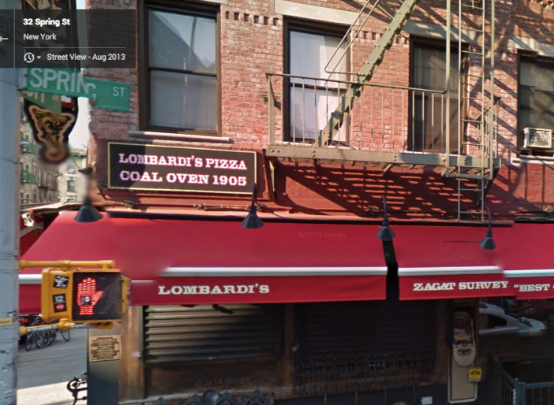
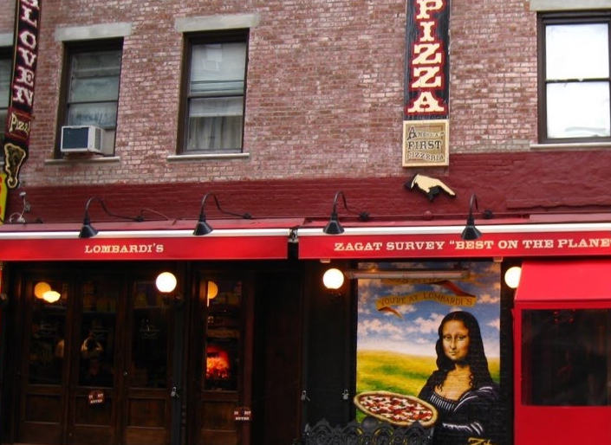
Lombardi’s Pizza
4.0
z
817 reviews
$$
5 min
Classic pizza joint
11:30 am - 11:00 pm
32 Spring St, New York NY 10012
Call
Save
Share
Street View
27 Photos
Add a photo

Slide 14
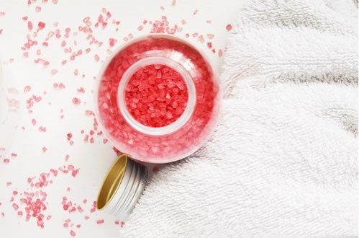
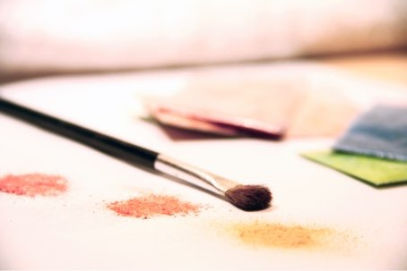

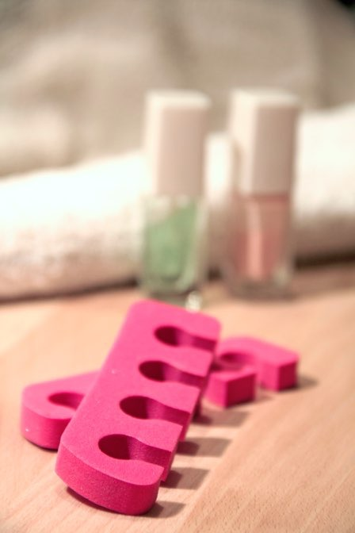
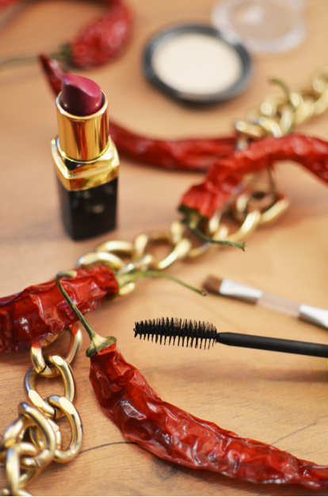

AT&T M-Cell
8:01 AM
92%
ARIA CLASSIC PIECES GOWN
PEACHES
Aria Classic Pieces Gown
(15)
REVIEWS
STYLIST NOTES
SIZE & FIT
SHARE WITH A FRIEND
$285
Retail: $2100
RESERVE NOW

Slide 15

Buy Now, or Keep for Later
Fleece Printed Layered Sweaters
$280.00
Little LuLu
Select Size
Select Color
Like
Keep
Buy
Browse
Web
Search
Cart
Me

Slide 16
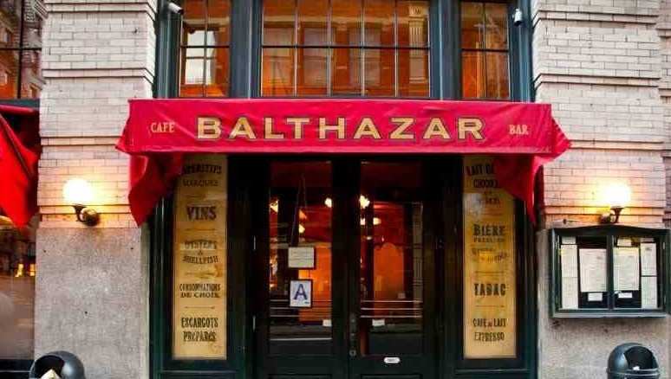
0:54 LEFT TO BOOK
DINING ROOM
BALTHAZAR
2
8:00PM, TONIGHT
PPL
“
Balthazar is the best everyday restaurant in New York City and it’s not even close.
NY Magazine
ADD CREDIT CARD
$20
RESERVE NOW

Slide 17
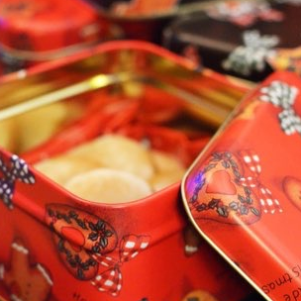







Share to
FOLLOWERS
DIRECT
Write a caption…
To:
Suggested
A
B
C
D
E
F
G
H
I
J
K
L
M
N
O
P
Q
R
S
T
U
V
W
X
Y
Z
joni
Joan Niveria
happyjoe
Joe Pizzulio
LharSy
Larry Simmons
MsKelly
Kelly Jones
gobatman
Bruce Wayne
SEND TO 2

Slide 18
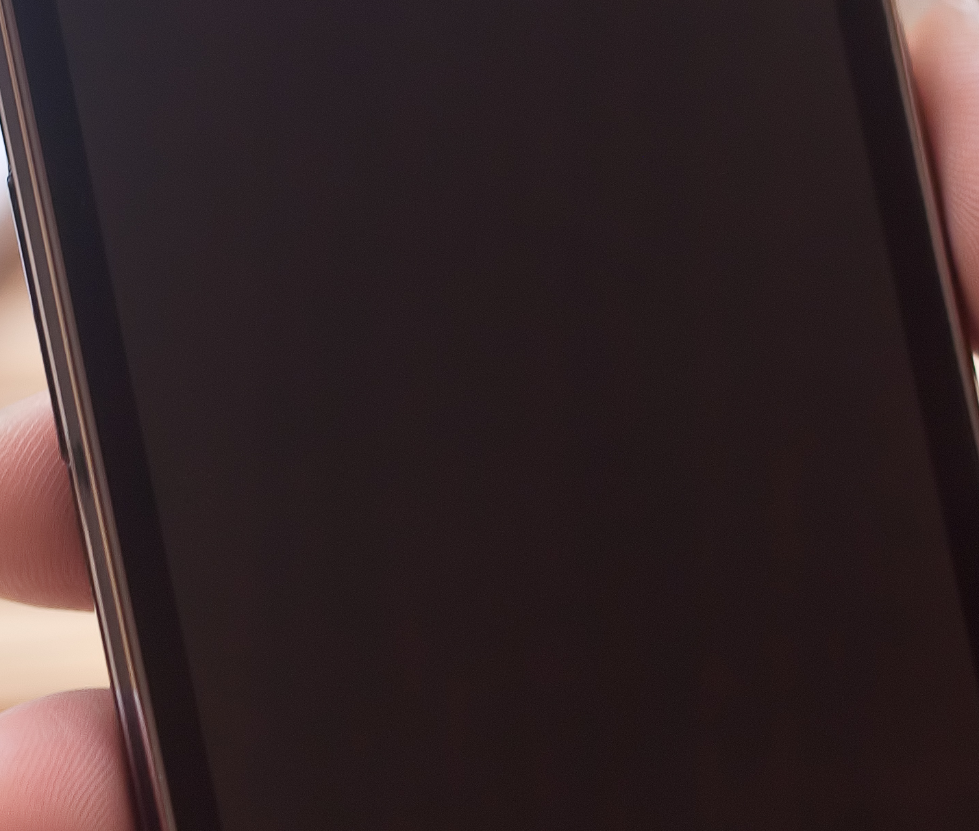
AT&T M-Cell
8:01 AM
92%
Edit
CART
Checkout
iPad Air Wi-Fi+Cellular
for AT&T 128 GB - Space
Gray
$929.00
Available to ship:
Within 24 hours
Available to pickup:
Today at Keynotopia Store, West L.A.
Gift Package
$5.00
Gift Message
Free
Cart subtotal
Your cart qualifies for free shipping
$929.00

1
Featured
Shop
Stores
Account
Cart

Slide 19


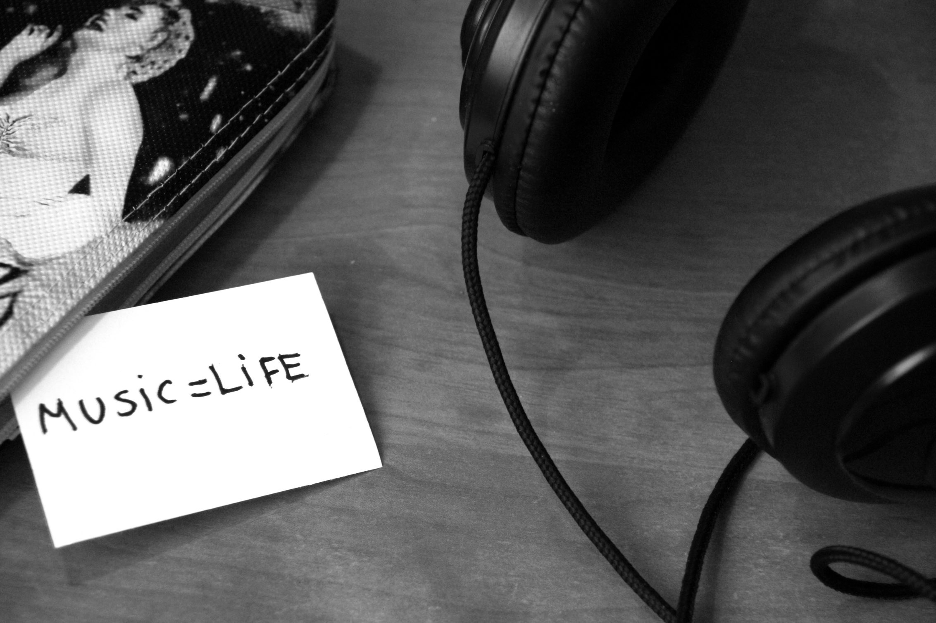
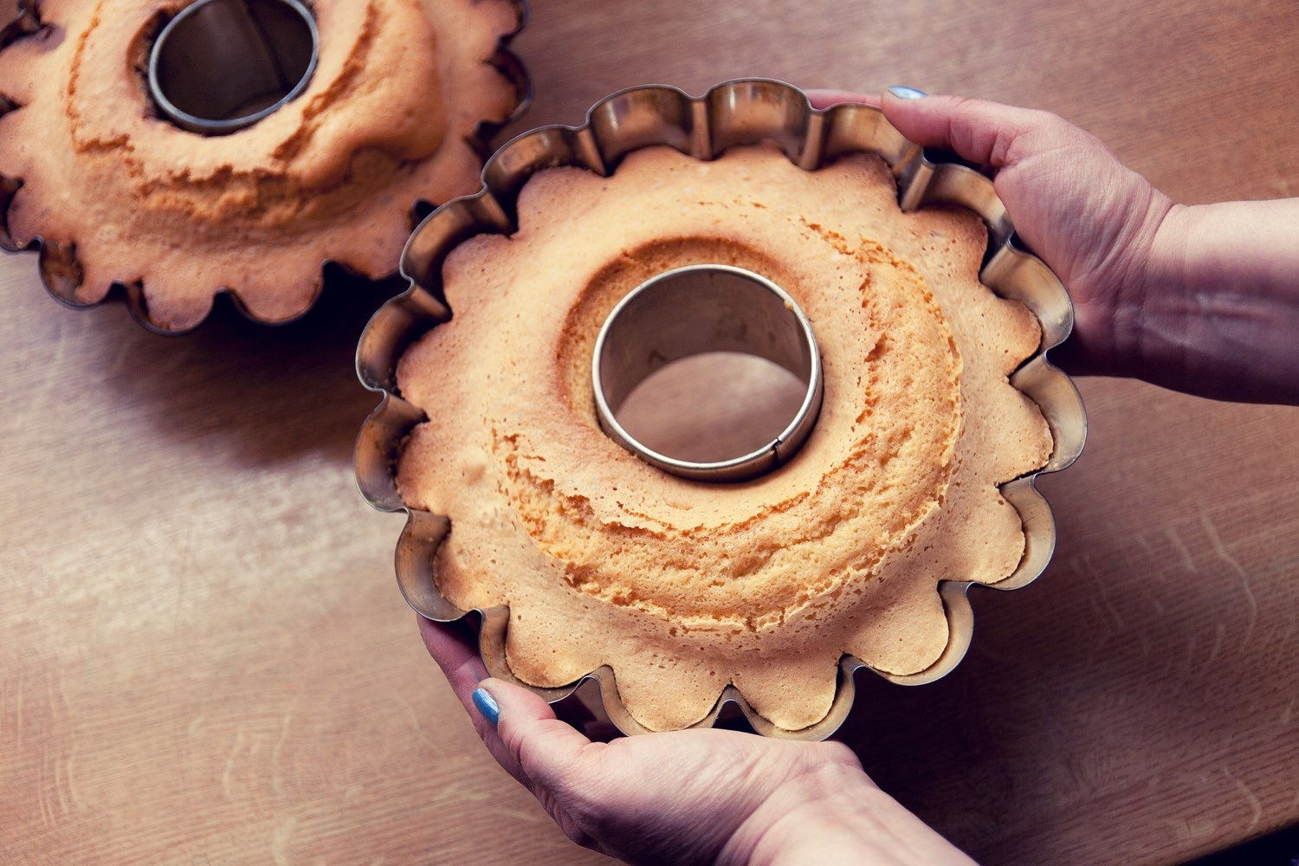
AT&T M-Cell
8:01 AM
92%
BACK
LIKE
CHECK OUT
TOTAL: $429.00
Tax and shipping cost will be calculated at checkout

Slide 20
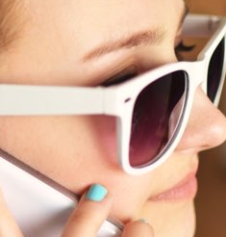

AT&T M-Cell
8:01 AM
92%
Edit
One Cart
History
Oakley White Sunn…
$280.00
S & R
Quantity: 1
Notes: Size 4, Color Red
Heart Cookies
$9.00
Royale Pastries
Quantity: 1
Notes: White/Red Sprinkles
Subtotal
$289.00
Coupon
Checkout
2
Browse
Web
Search
Cart
Me

Slide 21


AT&T M-Cell
8:01 AM
92%
TEQUILA SET
1h
SHIP TO
STEP 1 OF 2
Full Name
Street Address (Include Apt/Unit)
City
State
Zip
Phone
NEXT

Slide 22
CALENDARS

Slide 23
AT&T M-Cell
8:01 AM
92%
Calendar
New
July
2014
S
M
T
W
T
F
S
1
2
3
4
5
6
7
8
9
10
11
12
13
14
15
16
17
18
19
20
21
22
23
24
25
26
27
28
29
30
31
August
2014
S
M
T
W
T
F
S
1
2

Slide 24








AT&T M-Cell
10:24 AM
100%
3
S
M
T
W
T
F
S
May
27
28
29
30
1
2
3
4
5
6
7
8
9
10
TODAY
1
2
3
4
5
TUESDAY, APRIL 29
MORNING
48º
AFTERNOON
51º
12:00 PM
Training #2
1h
4:00 PM
Dining table pickup
2h
4:00 PM
Team Meeting
1h
Conference Room
4:00 PM
Team Meeting
1h

Slide 25
Verizon
12:10 PM
91%
CLOSE
DONE
WHAT’S THE EVENT?
Name
Festival
Date
Thu, October 10, 2013
Reminder
15 minutes before
OCTOBER 2013
S
M
T
W
T
F
S
29 | 30 | 1 | 2 | 3 | 4 | 5
6 | 7 | 8 | 9 | 10 | 11 | 12
13 | 14 | 15 | 16 | 17 | 18 | 19
20 | 21 | 22 | 23 | 24 | 25 | 26
27 | 28 | 29 | 30 | 31 | 1 | 2
3 | 4 | 5 | 6 | 7 | 8 | 9

Slide 26
Verizon
12:10 PM
91%
October 2013
WED
THU
FRI
WED
SAT
30
31
1
6
16
TODAY 10/30/13
Reminders
10/30
The Lake House…
starts at 8:00 PM
TOMORROW 10/31/13
10/30
The Lake House…
ends at 1:00 AM
FRIDAY 11/1/13
SY Board - 2014
Willis Tower, Chicago 4987/9,…
10:00 - 11:30 AM
John Smith’s Birthday
WEDNESDAY 11/6/13
Brandon Bailey’s 23rd Birthday
SATURDAY 11/16/13
Shirley Hurst’s 21st Birthday

Slide 27
Verizon
12:10 PM
91%
April 2014
Tue 29
Wed 30
Thu, May 1
All Day
Post: Rob Lee
Derick Ram…
Gus Hamil…
James Be…
10 AM
11 AM
12 PM
Training #2
Training #3
1 PM
2 PM
Tris +…
Tris +…
3 PM
4 PM
dinin
Te
Te
Ho
Fir
Firs
5 PM
6 PM
Drinks with…
Drinks with…
7 PM
Faye and Jim’s Post 4SQ 1:1’s
Francis Joyce Gil Michelle dinnah
8 PM
9 PM
10 PM

Slide 28
AT&T M-Cell
10:24 AM
100%
Cancel
New Event
Add
Start
Tue, Apr 29 - 11:00 AM
End
12:00 PM
Location
Time Zone
EDT
People
Calendar
Home
Alert 1
30 minutes before
Add Alert
More

Slide 29
PHOTOGRAPHY

Slide 31
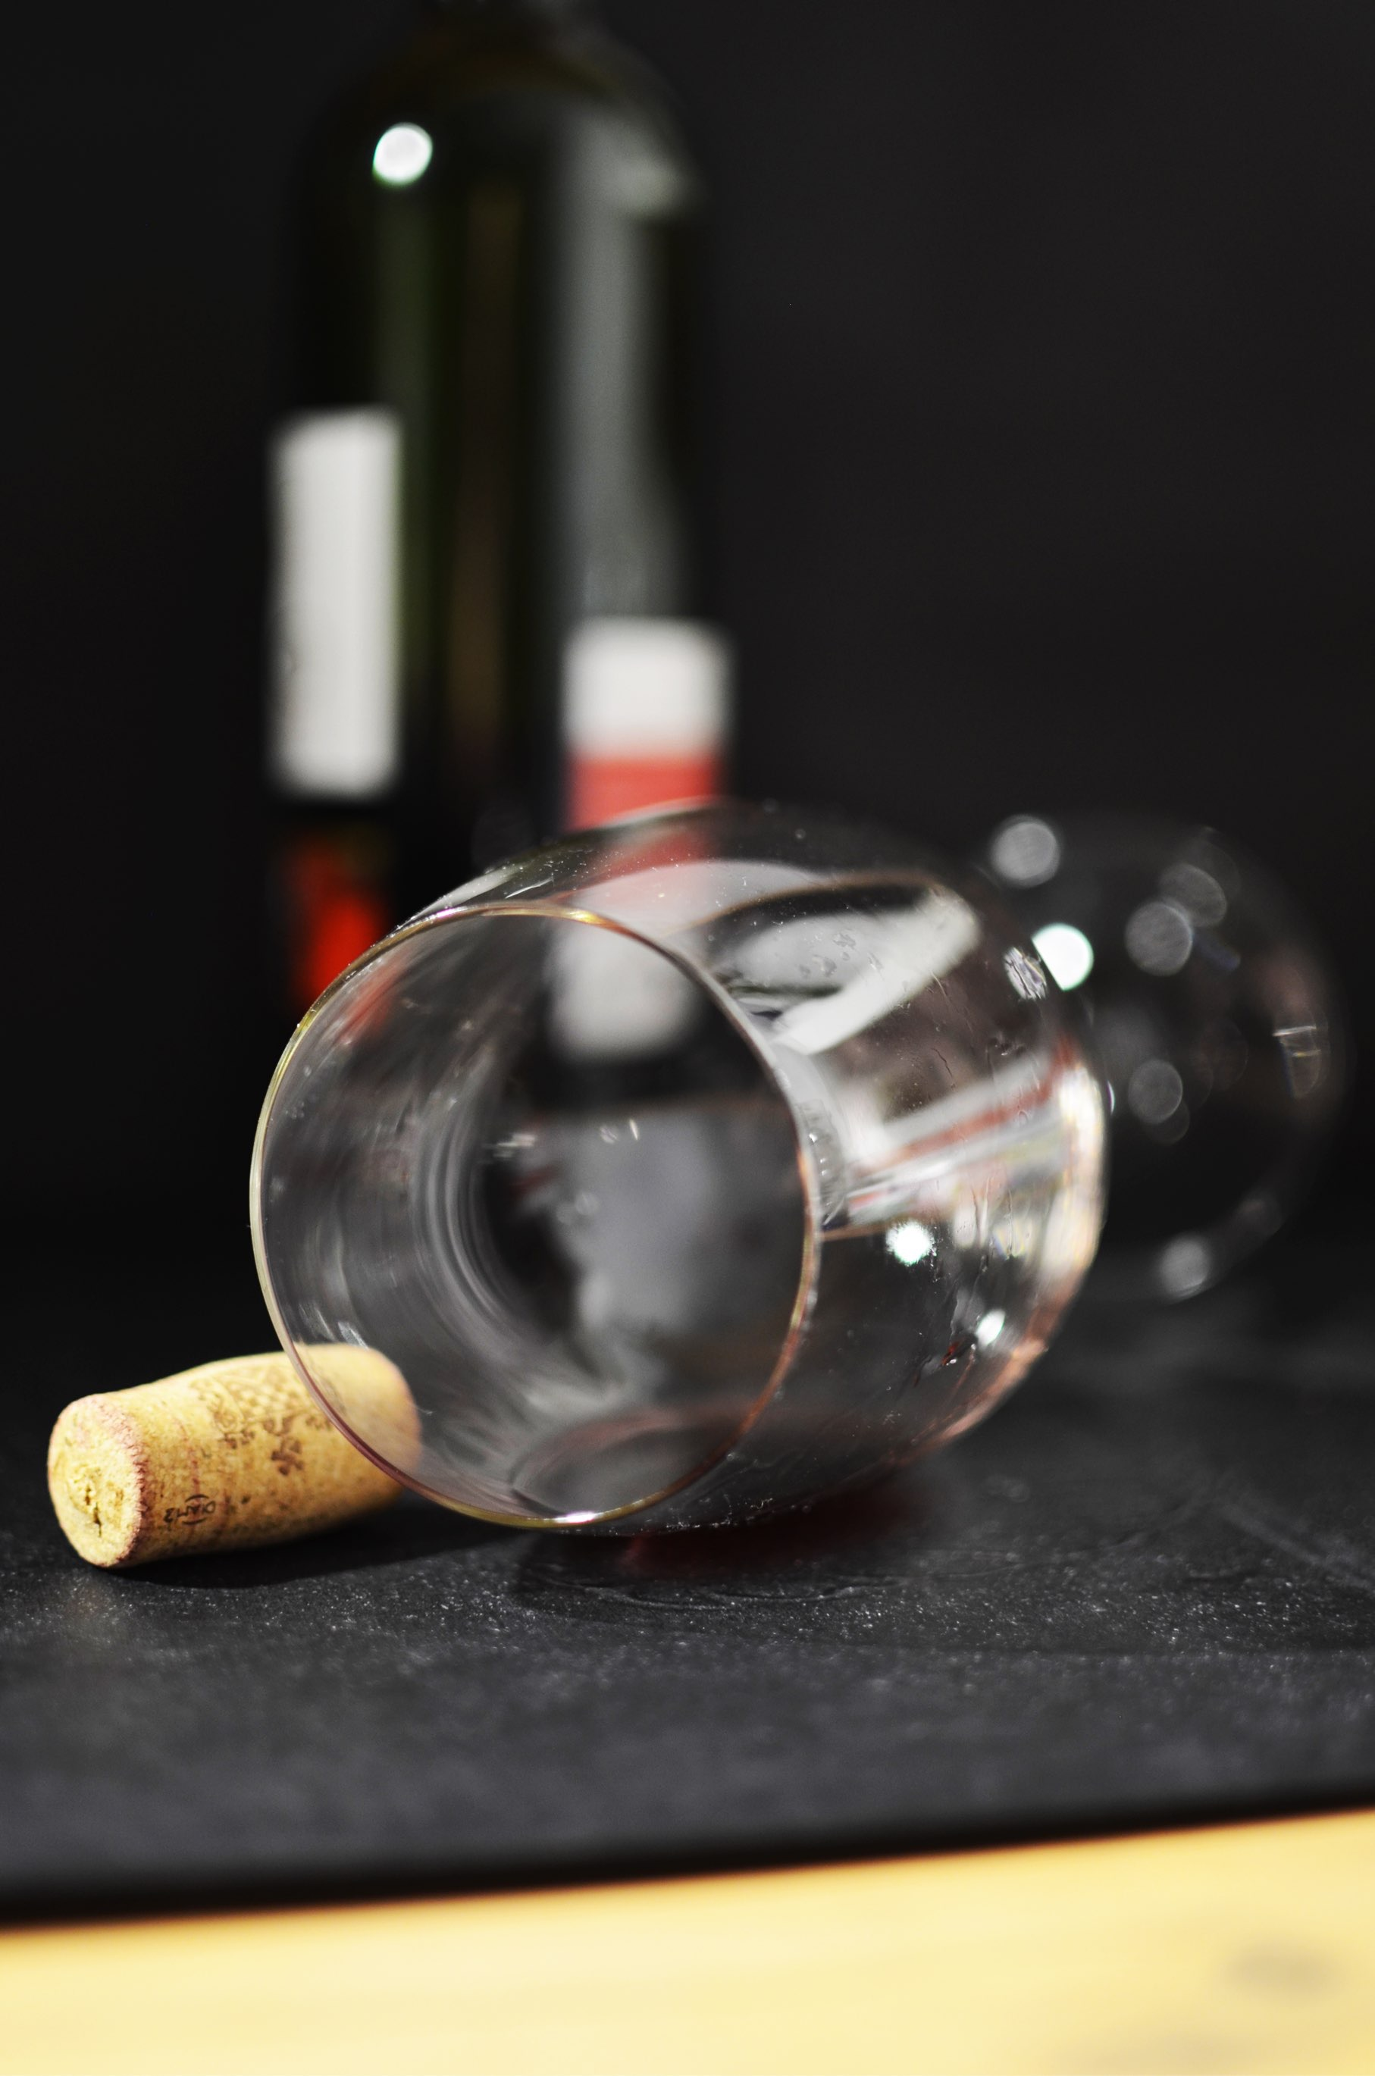

AW
AP 2.2
ISO 50
S 1/500
+
0

Slide 32

Library
EDIT
Next
Normal
HDR
Rise
Hu

Slide 33

Normal
Amaro
Mayfair
Rise
Hud

Slide 34
ACTIVITY FEEDS

Slide 35
AT&T M-Cell
8:01 AM
92%
Browse nearby
1
Rachel P. recently liked a tip at Subway:
“Nice outdoor seating right across the
street.”
Salad Bar 350ft
Mari
at
Cordell Fitness
2h
+3 points
4
renee b.
Kikkerland
5th Avenue, New York
2.1 mi
6m
Christy M.
Fat Denny’s
Broadway, NY
0.2 mi
1
6m
“
hellooooooo Foursquare 7.0!
James S.
Blue Ribbon Sushi
Sullivan Street, NY
21 mi
17m
“
Really excited to try this place out.
Paul D.
Alidoro
Prince, New
2
19m
“
Buddy lunch — with Geoffroy

Slide 36






AT&T M-Cell
8:01 AM
92%
Notifications
Frida liked your check-in at David Burke Kitchen
2 days ago
Jim liked your check-in at David Burke Kitchen
4 days ago
Kim & Hans left comments on Brian’s check-in at Charlie Bird
4 days ago
Miley & Jarno liked your check-in at David Burke Kitchen
4 days ago
Lou liked your check-in at Aquagrill
1 week ago
Abby F. wants to be your friend!
1 week ago

Slide 37






AT&T M-Cell
8:01 AM
92%
Activity
You
Friends
Everyone
Vicky Lewis wants to learn ‘How to Make Quilted Bedframe Cover’
1 minute ago
Cindy Williams liked ‘How to Make Banana Loaf with Crunchy Walnut Streusel
2 minutes ago
Atropos . commented on ‘How to Make Recycled Gift Wrappers’
Really cool thnx!
2 minutes ago
Mute
Tiffany Simmons liked ‘How to Bake Blueberry Cheesecake’
2 minutes ago
Karen Davis liked ‘How to Curve Batman Pumpkins
2 minutes ago
Hazel Scott liked ‘How to Be

Slide 38











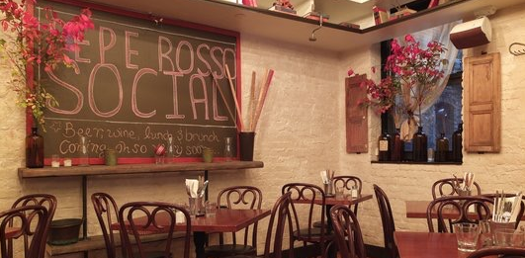

AT&T M-Cell
8:01 AM
92%
Activity Feed
Edit
November 30, 2013
Sarabeth at Central Park South
Manhattan 8:50 PM
Flatbush Farm
Brooklyn 7:35 PM
Cookshop
Chelsea St. 5:13 PM
Pepe Rosso Social
173 Mott St 3:33 PM

Slide 39



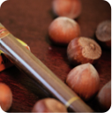










AT&T M-Cell
8:01 AM
92%
Notifications
Kris commented on Banyan Tree Island Resort @ Maldives.
“@deemer78 her favorite place is a place she has never been to? interesting lol”
deemer78 commented on Banyan Tree Island Resort @ Maldives.
“one day I will go there with my sweet heart my princess I know it’s her favorite place !”
feist44 commented on Teeny Bopper Tees.
“Hottie”
jody commented on Banyan Tree Island Resort @ Maldives.
“impressionante di grande effetto.”
frnkl1n commented on Relaxing Cotton
“I hope this isn’t available in Germany”
aproditee commented on Photo App Masterpiece.
“cool”
kd67 commented on Blue Snickers.

Slide 40
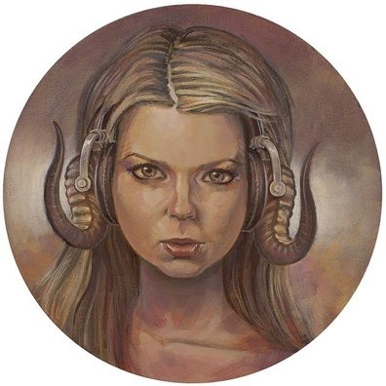
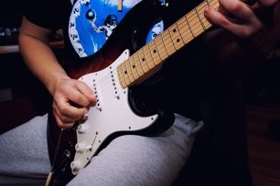


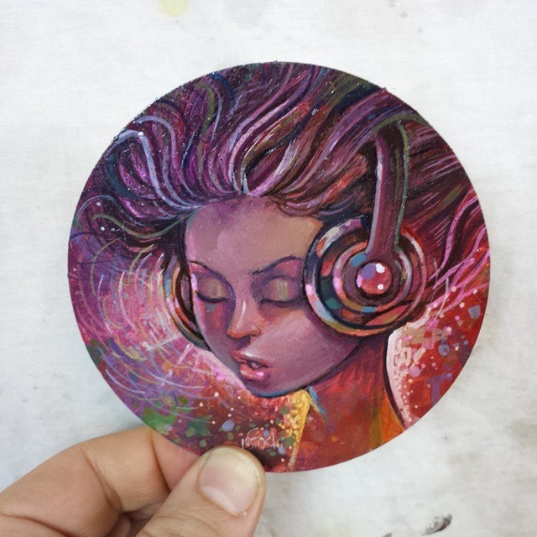

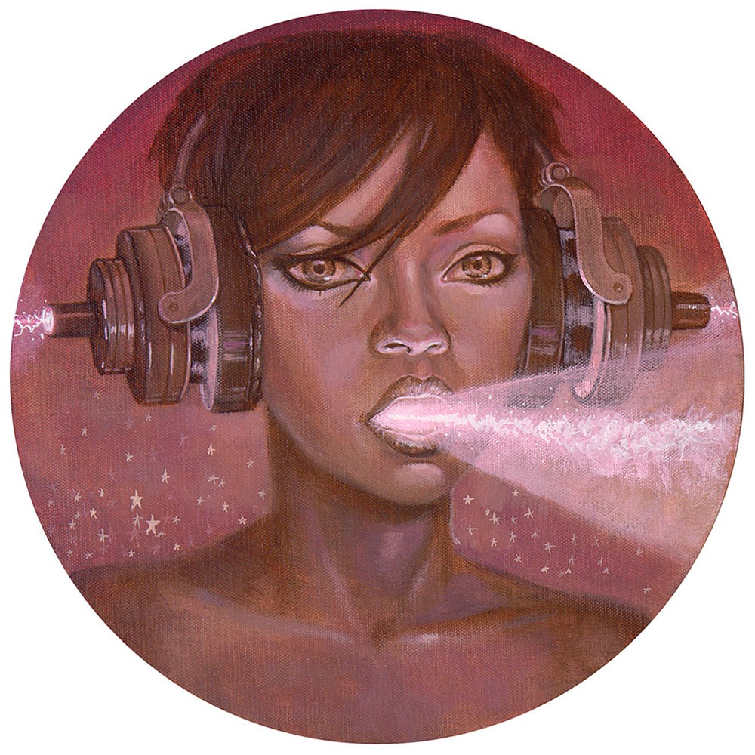
AT&T M-Cell
8:01 AM
92%
Back
Profile
Your Notifications
Rafael Durani
followed your work
Bouvché Clicq
followed your work
Sid Lucero
followed your work
Phil08
appreciated your work
www.icewarp.com
Martin D. Scocese
followed your work
Luis Allandy
followed your work
Rickee Dane
followed your work

Slide 41
AT&T M-Cell
8:01 AM
92%
Feed
A toast to Richard for giving me An Astra!
Cheers!
4
2
Joseph
Joseph wished for An Astra
Matic Depot
3
2
Wish
Joseph wished for Ice Cream
Bake ’n Churn
3
0
Wish

Slide 42

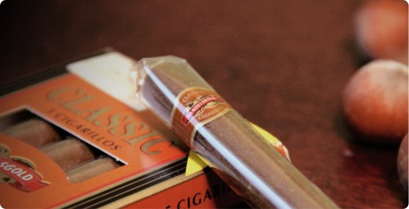


AT&T
4:58 PM
79%
````
````
Home
Fashion Cop
@FashionCop
48m
This is 100% not an endorsement of @vanitymag’s winner, but pls note the difference well-groomed hair makes on a man
Verly @verlyvy
1m
@FashionCop how did he even get on that list? sheesh - i’m going to cancel my people mag subscription now. HAHAHAHA
IT: GURU @ITguru
1m
How Win’s attempt to revolutionize TV ended up a disaster read.bi/
@
Home
Connect
Discover
Me

Slide 43




AT&T M-Cell
8:01 AM
92%
Explore
Eggy heads (painted paper mache over cardb…
by
Gary House
2
6
Lego stop motion: Revolutionary war part 3
by
Jeoffrey
7
10

Slide 44




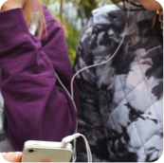

AT&T M-Cell
8:01 AM
92%
Menu
Timeline
January 2013
Hike in Point Reyes to
Alamere Falls with Court
and Naveen
2:46 PM
14
Coast Trl, Point Reyes Sta… 46º
MONDAY
Another day of hiking.
Today: Mount Diablo.
Love the different terrai…
5:46 PM
12
Mount Diablo State Park,… 46º
SATURDAY
A little trip to photojojo
8:59 PM
11
766-770 Valencia st, San… 48º
FRIDAY
I’ve wanted to get my
tintype portrait for a long
time. Happy to knock th…
6:34 PM
11
1195 Valencia St, San Fra… 50º
FRIDAY
Spent the day in the
woods
10:53 PM
10
San Francisco, California,… 46º
THURSDAY
Baby’s first time over the
Golden Gate Bridge
4:44 PM
10
Golden Gate Brg N, San… 50º
THURSDAY

Slide 45


AT&T M-Cell
8:01 AM
92%
Wednesday
Sunday, December 1
7:00PM
Sunday Evening

Slide 46
WEATHER

Slide 47
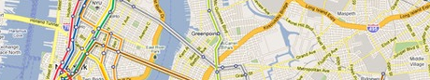
AT&T M-Cell
8:01 AM
92%
Search
Get directions
See this icon?
This app checks your location to pinpoint the info you need. That’s why you see the compass icon. Don’t worry. the location updates don’t require GPS and have minimal impact on your battery.
Change settings & learn more
New York
84
º
CLEAR
2
mph
20%

Slide 48
AT&T M-Cell
8:01 AM
92%
TODAY
46ºF
51
44
Sunny
TUE
51
44
WED
53
42
THU
52
44
52
44
FRI
51
41
SAT
49
42

Slide 49
COMMENTS

Slide 50


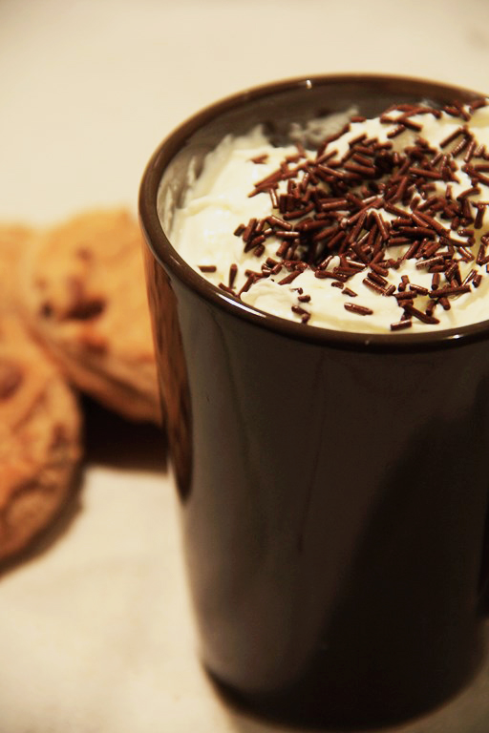
AT&T M-Cell
8:01 AM
92%
Patty Woods
2 years ago
So this happened…and it was amazing.
Janelle So, kusawa hiroko, Chetali Pradim
Patty Woods
One of the highlights of my
17h
time--Four Loko and cheese tasting I coordinated two years ago. RIP, original formula.

Slide 51

AT&T M-Cell
8:01 AM
92%
technohub
Change location
Arrived a
Cancel
Check In
Q
W
E
R
T
Y
U
I
O
P
A
S
D
F
G
H
J
K
L
Z
X
C
V
B
N
M
123
space
@
#

Slide 52
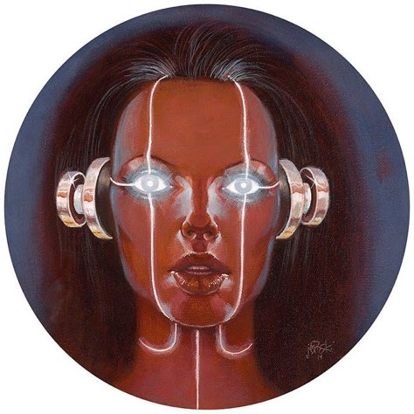
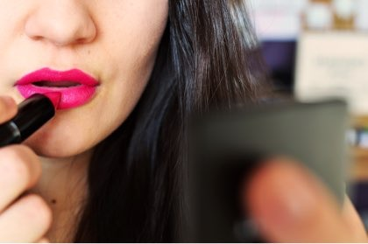
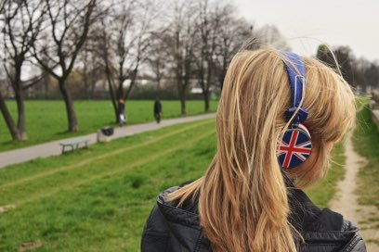
Likes
+195
Comments
Load Previous Comments…
Becca J Winston
yeah. why not.
4 HRS
Jorge Junior likes this.
Red Boot Shares
I get people being upset about the rents going up and all, but I don’t understand all that hate. I would be willing to bet most of these people spewing hatred towards Google have a gmail account, no?
4 HRS
3 people like this.
Tracy Wright
We can’t until we hear back from the NSA.
4 HRS
Write something…
Post
200 Likes 29 Comments
Write a comment

Slide 53

AT&T M-Cell
8:01 AM
92%
Robin’s Activity
Cedrick Mallic
tweeted 4d ago
Yeah! I finally pushed a BIG update to @pttrns and we now support iPad as well.
http://pttrns.com/ipad
from Manhattan
Send a reply…
Send
Q
W
E
R
T
Y
U
I
O
P
A
S
D
F
G
H
J
K
L
Z
X
C
V
B
N
M
123
space
@
#

Slide 54
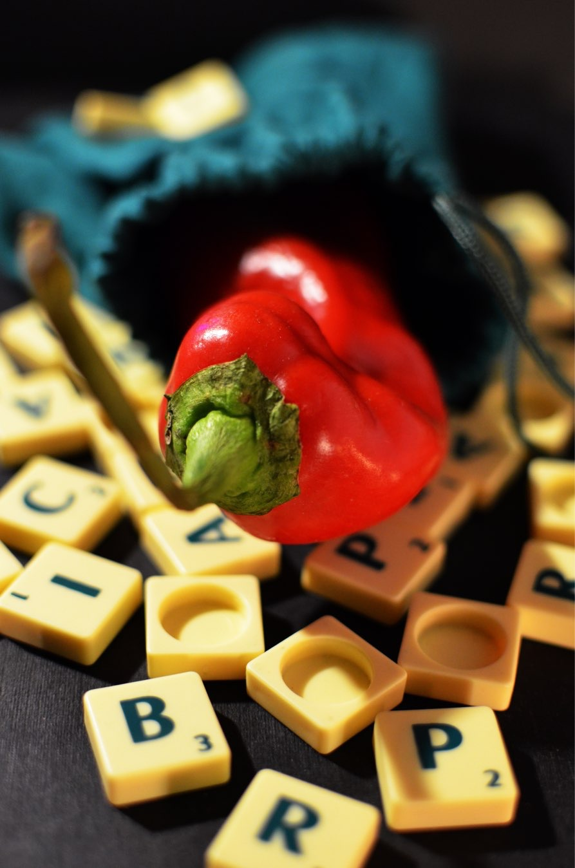

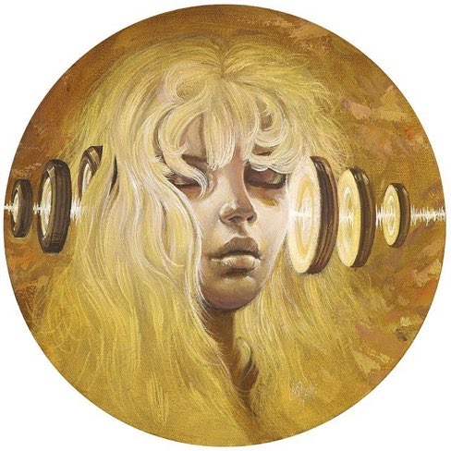


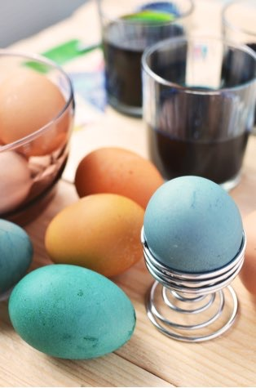

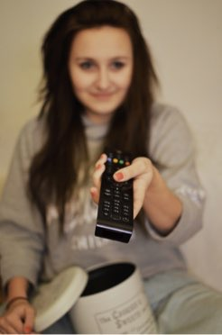

AT&T M-Cell
8:01 AM
92%
Atoll’s Cocoa Island
1 hour
Left or right?
Follow
@stylepolice
www.stylepolice.com
200
Likes
martina and 199 others
Mentions
StylePolice
Comments
Annabela
1 hour ago
both
Kirsteneli
1 hour ago
Type your reply…

Slide 55

AT&T M-Cell
8:01 AM
92%
Comments
Lipsy
Amazing !
11 MINUTES AGO
Darren Bellezin
Make one but peel it
this time
11 MINUTES AGO
Antoinette Bourdain
Love time lapses
6 MINUTES AGO
helene evans
Awesome!
5 MINUTES AGO
Say something nice
Send
Q
W
E
R
T
Y
U
I
O
P
A
S
D
F
G
H
J
K
L
Z
X
C
V
B
N
M
123
space
return

Slide 56
AT&T M-Cell
8:01 AM
92%
Cancel
Reblog
Post
M
marsbot
Q
W
E
R
T
Y
U
I
O
P
A
S
D
F
G
H
J
K
L
Z
X
C
V
B
N
M
123
space
return

Slide 57
AT&T
9:29 AM
41%
````
Cancel
New Message
To:
Name, Phone, or Email
What’s the message?
Send
Q
W
E
R
T
Y
U
I
O
P
A
S
D
F
G
H
J
K
L
Z
X
C
V
B
N
M
123
space
@
.
return

Slide 58
AT&T M-Cell
8:01 AM
92%
Share
Exactly 4 years ago today! (via keynotopia.com)
More
Post
Q
W
E
R
T
Y
U
I
O
P
A
S
D
F
G
H
J
K
L
Z
X
C
V
B
N
M
123
space
return

Slide 59
AT&T M-Cell
8:01 AM
92%
When
New Task
Notes
Tue, 25 Mar
12:04 AM
No-Repeat
Cancel
Done
Q
W
E
R
T
Y
U
I
O
P
A
S
D
F
G
H
J
K
L
Z
X
C
V
B
N
M
123
space
return

Slide 60
MENUS

Slide 61
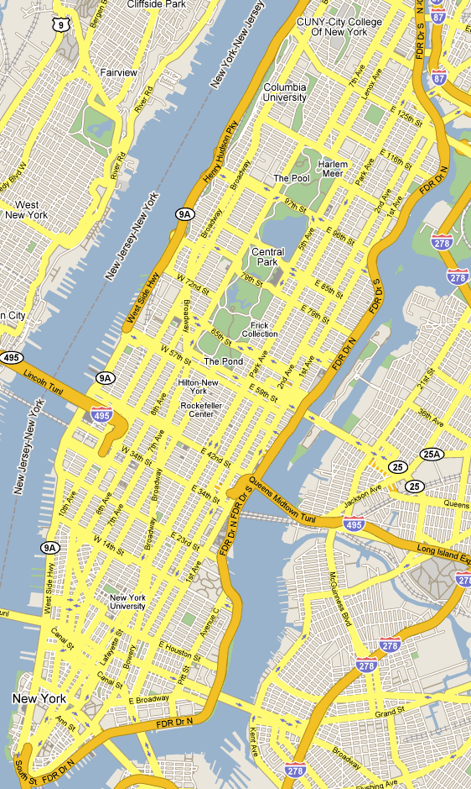
Traffic
Public transit
Bicycling
Satellite
Google Earth
Settings
Help
Send feedback
Tips and Tricks

Slide 62

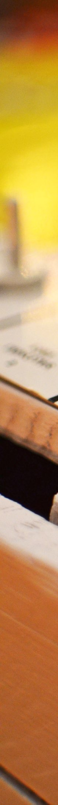
Profile
Home
Messages
Settings
+
Invite

Slide 63

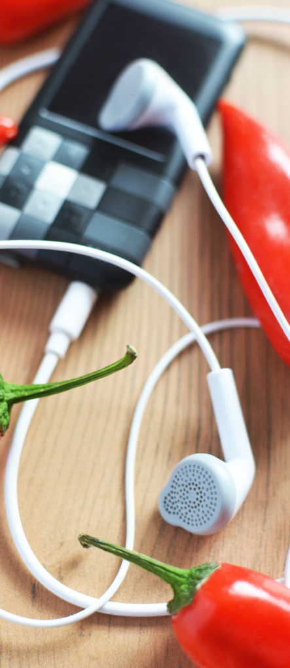
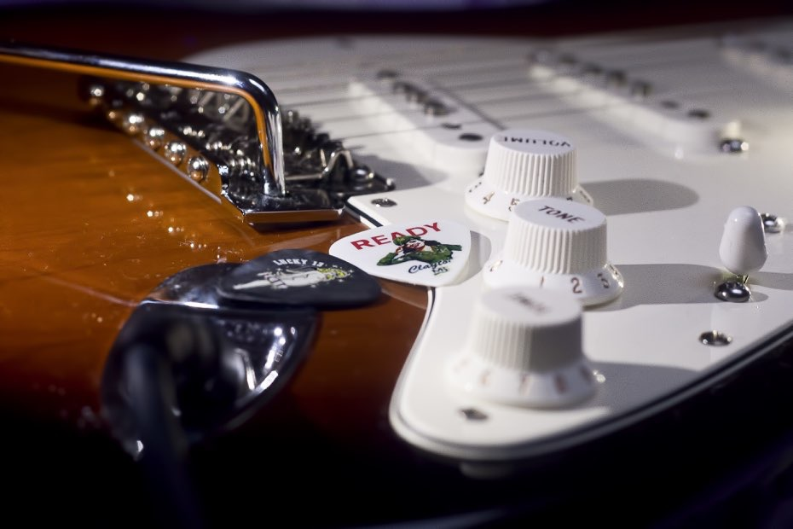


LMITCHELL
Journal
Settings
Store
Library
Camera

Slide 64


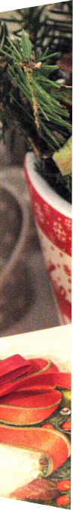
AT&T M-Cell
8:01 AM
92%
Lara Mitchell
Travel
Search
Discover
Your Trips
Wish Lists
Inbox
1
Host

Slide 65

AT&T M-Cell
```
8:01 AM
92%
Search: people or places…
Lara Mitchell
Home
Trending
My Trips
1
Find Friends
AT
Notifications
2
i

Slide 66

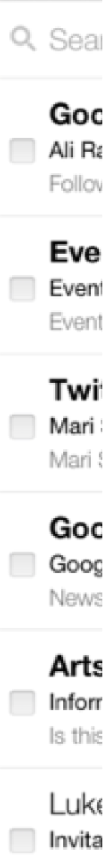
AT&T M-Cell
8:01 AM
92%
lmitchell
@gmail.com
Inbox
11
Unread
Everything
Important
99+
Sent Mail
Drafts
3
Labels
Trash
Accountant
2
accounts
2
family

Slide 67

AT&T
9:29 AM
41%
````
Menu
Home
Search
My Yums
Shopping List
Settings
New Recommendations

Slide 68
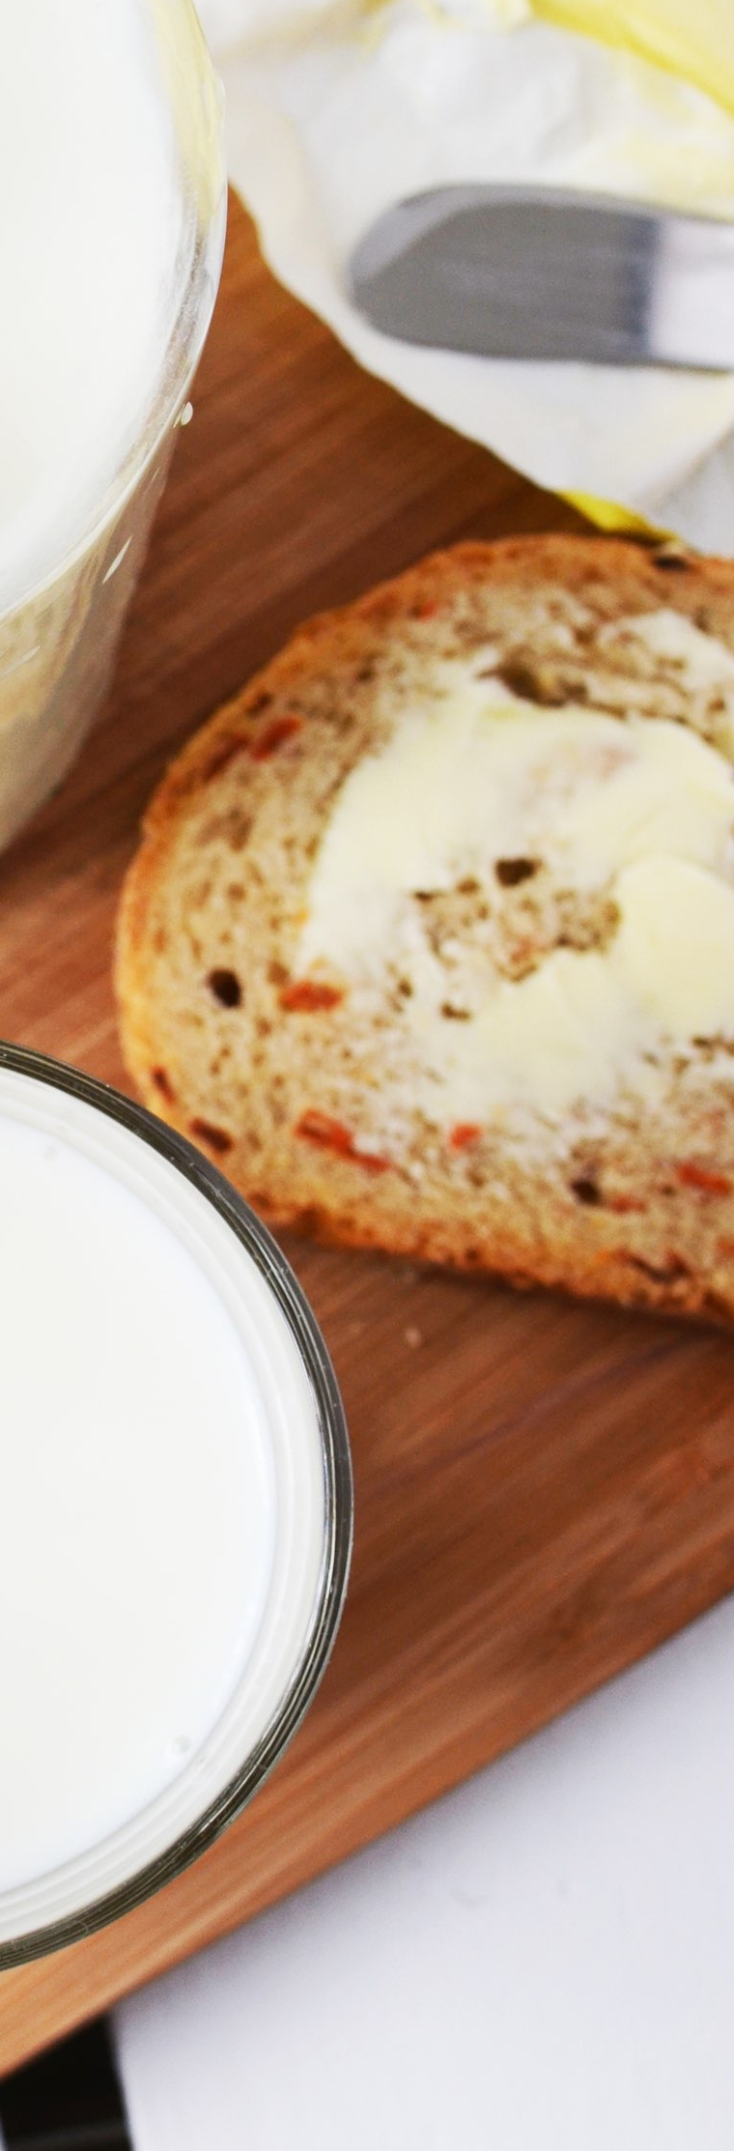
AT&T
9:29 AM
41%
````
Add to Yums
New Collection
Sides
Drinks
Breakfasts
Desserts
Dinners
A la Cremé Sandwich
ABC Kitchen
Ingredients
Nutrition
Directions
5
20
Count
Calories
Minutes

Slide 69
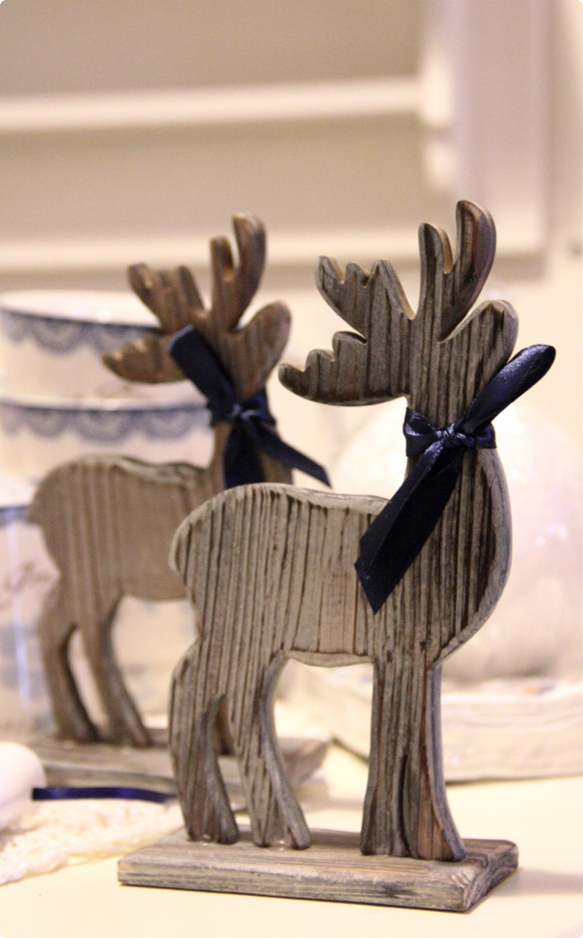
AT&T M-Cell
8:01 AM
92%
Share
Like this guide?
Let others know!
We’ll share your appreciation with
the author and show your likes on
your profile.
OK
Comment
Supplies
Step 1 of 20

Slide 70
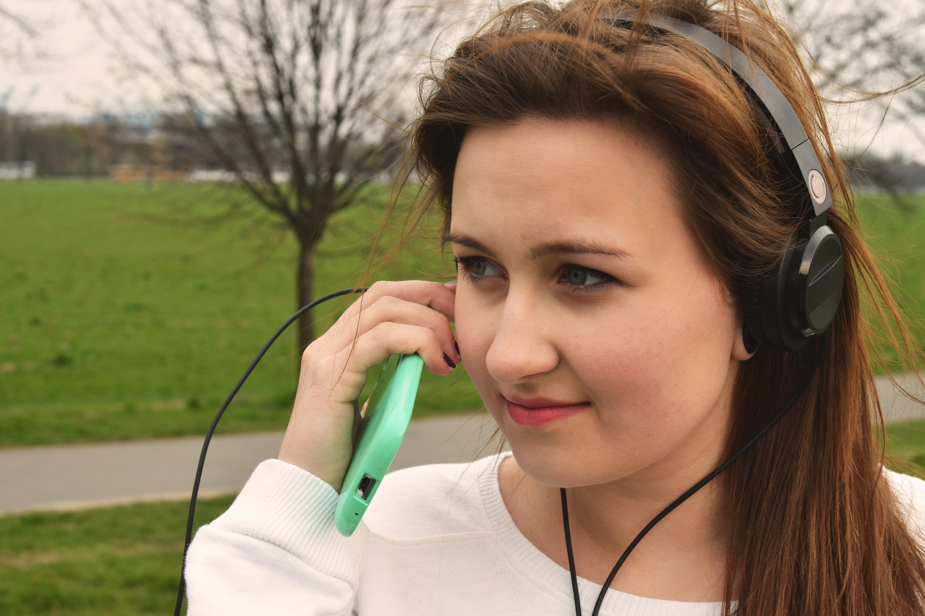
Edit Later
Delete Image
0:05
0:01
6x

Slide 71
BROWSE
AND SEARCH

Slide 72
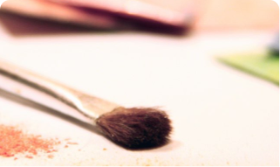



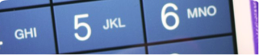

AT&T M-Cell
8:01 AM
92%
Search Guides
Recent
Popular
TOPICS
Arts & Crafts
Automotive
Beauty
Desserts

Slide 73
AT&T M-Cell
8:01 AM
92%
Search
Cancel
Explore nearby
Eat
Drink
Play
More
Groceries
Pharmacies
Q
W
E
R
T
Y
U
I
O
P
A
S
D
F
G
H
J
K
L
Z
X
C
V
B
N
M
123
space
Search

Slide 74

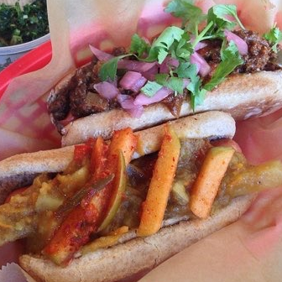
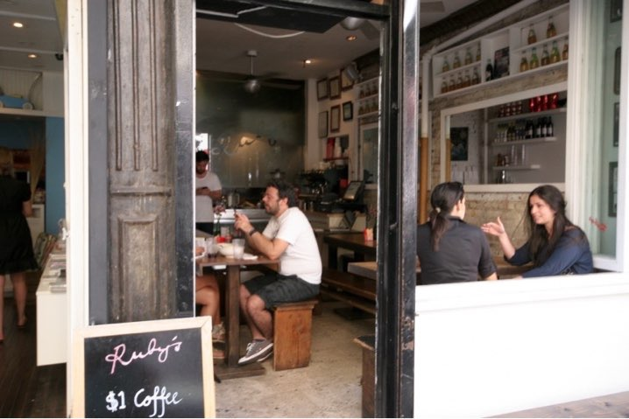
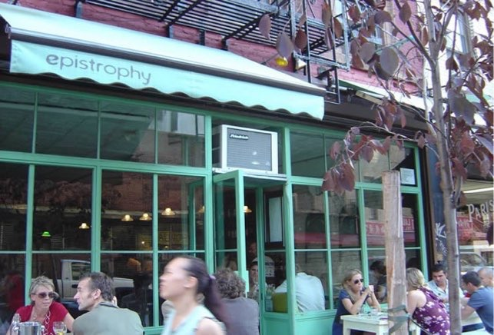
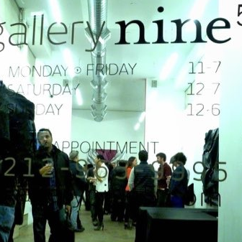

AT&T M-Cell
8:01 AM
92%
List
Map
Edit
My to-do list
1.
Sausage Point
Hot Dog Joint
500 ft · 66 Kenmare St (btwn…
2.
Café & More
Coffee Shop
600 ft · 219 Mulberry St (btwn…
3.
GreenLeaf
Tea Shop
700 ft · 200 Mott St (btw Ken…
4.
D’ Gallery
Art Gallery
800 ft · 24 Spring St (at Elizab…
5.
Dental Nook

Slide 75
AT&T M-Cell
8:01 AM
92%
Map
New York
Subway Map
Line Status
Favorites
Get Me Somewhere
Get Me Home
Get Me To Work
My Places
Times Square (sample place)

Slide 76
AT&T M-Cell
8:01 AM
92%
Dinner for 2 today
New York City
DEL POSTO
Hip Italian • $
8:00PM
DINING ROOM
12 min drive
TERTULIA
Downtown Chic • $$
7:30PM
DINING ROOM
13 min drive
MAIALINO
Italian • $$$
8:00PM
DINING ROOM
13 min drive
PARM
8:00PM

Slide 77
AT&T M-Cell
8:01 AM
92%
Contacts
Search…
Cancel
SUGGESTED SEARCHES
san francisco, california
start-ups
photography
political science
Q
W
E
R
T
Y
U
I
O
P
A
S
D
F
G
H
J
K
L
Z
X
C
V
B
N
M
123
space
Search

Slide 78
AT&T M-Cell
8:01 AM
92%
pi
Cancel
pizza
Pike Street
Pine Street
Pitt Street
Q
W
E
R
T
Y
U
I
O
P
A
S
D
F
G
H
J
K
L
Z
X
C
V
B
N
M
123
space
Search

Slide 79
AT&T M-Cell
8:01 AM
92%
Cool
Hashtags
User
#cool_material
6 items
#cool
6 items
#thecoolbrand
2 items
#cooler
2 items
Q
W
E
R
T
Y
U
I
O
P
A
S
D
F
G
H
J
K
L
Z
X
C
V
B
N
M
123
space
Search

Slide 80
AT&T M-Cell
8:01 AM
92%
Cancel
Filters
Done
Enter address, city or neighborhood
FILTERS
PRICE RANGE
Any
to
$6,000
BEDROOMS
Studio
1
2
3
4+
PETS
PHOTOS
Dogs
Cats
KEYWORDS
Example: balcony, garage, etc.

Slide 81
AT&T M-Cell
8:01 AM
92%
Check In
Search
1510 Lexington
1510 Lexington Ave.
90 ft
ADB
1504 Lexington Ave.(at E 97th…
200 ft
Wellness Pharmacy
1500 Lexington Ave.(at 97th)
250 ft
The English Pub
1259 Park Ave (btwn 97th & 98…
300 ft
Sweet Dough & Nuts
1261 Park Ave (97th St)
350 ft
Birds Bar and Grill
1649 3rd Ave (btwn E 92nd &…)
0.3 mi
The Monks Inn

Slide 82
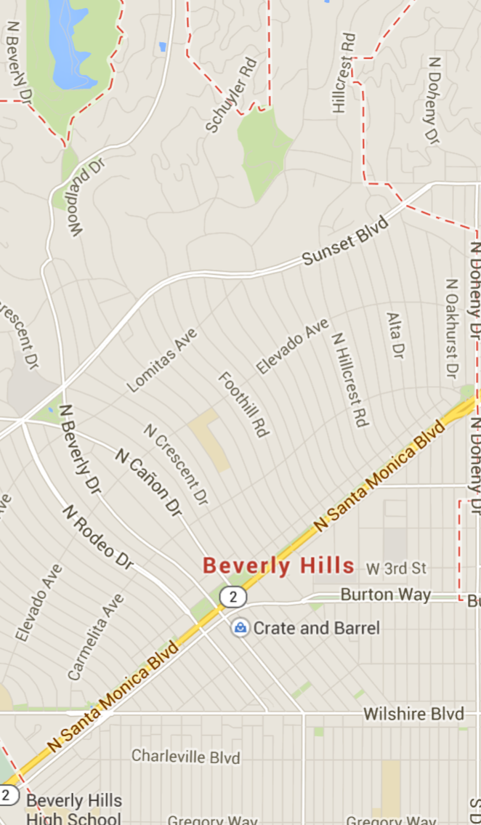
AT&T M-Cell
8:01 AM
92%
New York
N
$201
$234
$186
$174
$176
$139
$199
$200
$949
$171
$164
$199
$185
$155
$542
$185
$178
$206
$171
Filters

Slide 83
AT&T M-Cell
8:01 AM
92%
Meet Me
Columbus Circle
My Location
Share Location

Slide 84
AT&T M-Cell
8:01 AM
92%
Cancel
Pick a location
Search for a location
Use my current location
Nearby locations
Broadway

Slide 85
AT&T M-Cell
8:01 AM
92%
Filters
Search
7
5
1
4
14
5
6
1
1
4
17
28
22
5
28
2
17
39
34
28
Search
Favorites
Alerts
Renter Card
Pay Rent

Slide 86
AT&T M-Cell
8:01 AM
92%
PAY
STORES
GIFT
Search Stores
Filter
29th & Lexington Ave
1491 Lexington Avenue
427 ft
Open until 11:00 PM
96th & Madison
1378 Madison Avenue
0.2 mi
Open until 10:30 PM
92nd & 3rd
1642 Third Avenue
0.3 mi
Open until 11:00 PM

Slide 87
GALLERIES

Slide 88




AT&T M-Cell
8:01 AM
92%
Featured trips for you
6 days left
The Landmark
—London
6 days left
Ecoventura Galapagos Cruise
—Galapagos
1 day left
Featured
Tonight
Search
More

Slide 89





AT&T M-Cell
8:01 AM
92%
Lipstick samples from the Avon lady who sold door to door. {Had one of these—my mom sold Avon}
Sitting backwards in the station wagon
1
Repin
.
Like
Repin
.
Like
Lou Harrison /…
Lou Harrison /…
Blast From My Pas…
Blast From My Pas…
I loved this show.
Repin
.
Like
45’s and inserts
Lou Harrison /…
Blast From My Pas…
1
Following
Explore
News
Profile

Slide 90



AT&T M-Cell
8:01 AM
92%
Graphic Design: Identity
Sarabeth’s
by Sheila Dixon
71
Branding, Grap…
RED CHILLIS
by Josh Claveria
371
Art Direction….
Docket Vol. 01— 04
by Anonymous
1310
Creative Dire…
Imperial Design Award 2012
by Anonymous
697
Creative Direc…
Oligarchy

Slide 91





AT&T M-Cell
8:01 AM
92%
PLAYLISTS
Edit
GUITAR UNPLUGGED
by Filtr US • 218 tracks
Best of HipHop Vol.1
76 tracks
Mariah Carey — Glitter
37 tracks
Pearl Jam - Lightning Bolt
18 tracks
Green Day - American Id…
16 tracks
Frank Sinatra - Chairman…
34 tracks
Kenny G - Kenny G Live
8 tracks
What a Wonderful World
Loius Armstrong

Slide 92



AT&T M-Cell
8:01 AM
92%
Popular with tourists
Chrysler Building
4.5
1,042 reviews
103-story landmark with observatories
3.2 mi • 8:00 am - 2:00 am
Wythe Hotel
4.5
580 reviews • $$$
Buzzy upscale hotel with a hip vibe
2.6 mi
5 Pointz Aerosol Art Center
4.5
737 reviews
World-class sculpture, art & design
2.2 mi • 10:30 am - 5:30 pm
Discovery Times

Slide 93












Slide 94







AT&T M-Cell
8:01 AM
92%
EXPLORE
Search users and hashtags

Slide 95




AT&T M-Cell
8:01 AM
92%
Heavy Rotation
La Traviata
Fever
New York Philharmonic…
Peggy Lee
50 songs
13 songs
At Last
Fine And Mellow
Etta James
Billy Holiday
10 songs
36 songs
Misty
Sarah Vaughan

Slide 96


















AT&T M-Cell
8:01 AM
92%
Albums
Camera Roll
476 Pictures
Camera Roll
476 Pictures
Foursquare
22 Pictures
Fruit Juicing
14 Pictures
Lomography
9 Pictures

Slide 97














AT&T M-Cell
8:01 AM
92%
Photos
Turn on Camera Upload
Enable
Auto-upload your photos
LAST WEEK
THIS MONTH

Slide 98

AT&T M-Cell
8:01 AM
92%

Slide 99






AT&T M-Cell
8:01 AM
92%
Register
Login
Similar
Collections
Comments
HollyDay Collection
by Jessica White
Indulgence
by Kelly Matthews

Slide 100





AT&T M-Cell
8:01 AM
92%
Etsy
Sign In
Search handmade and vintage
$7
$45
$25
$27
$30
Popular Treasury Lists
I Wish We All Could Be California Girls!
E

Slide 101
SETTINGS

Slide 102
AT&T M-Cell
8:01 AM
92%
Account
Order Status
My Reservations
Receipts
Account Settings
Notifications
Order Status
Appointment Reminders
iPhone Upgrade Eligibility
We’ll notify you on your next eligibility date.
Learn More
Featured
Shop
Stores
Account
Cart

Slide 103
AT&T M-Cell
8:01 AM
92%
Account
Log Out
Profile
Settings
Help
Invite Friends
Enter Referral Code
Love this app?
How It Works
Why Host?
Terms Of Service

Slide 104
AT&T M-Cell
8:01 AM
92%
Close
Settings
Save
kristoff
sirky@me.com
Change
Connect to Facebook
Connect to Twitter
Connect to Instagram
Change password
Hide my posts from discovery

Slide 105
CHARTS

Slide 106
AT&T M-Cell
8:01 AM
92%
Back
What are Insights?
Activities by Distance
See how many activities you’ve done at
certain distances, and select a specific
group to see how your pace and mileage
changes.
Average Pace Per Week
See how your pace has gotten better (or

Slide 107
AT&T M-Cell
8:01 AM
92%
Back
3/20/11, 7:3…
Options
TIME
08:19
1:50:37
Avg min/mi
1,892
Calories
13.29
10:38
Miles
Min/Mi

Slide 108
CONTACTS

Slide 109







AT&T M-Cell
8:01 AM
92%
People
Search
A
A
B
C
D
E
F
G
H
I
J
K
L
M
N
O
P
Q
R
S
T
U
V
W
X
Y
Z
#
Abraham Albert
Alex Hamilton
Ambrose McCue
Annika Kudovisky
Apple Pullber
Armine Simone
B
Basty Gomez
Messages
Status
People
Me

Slide 110








AT&T M-Cell
8:01 AM
92%
Friends
Contacts
Friends on here
Alfred Donnovan
alfdon
Add
Mario Gomez
mariogomez
Add
Sharon Filler
fillers
Add
Friends to invite
Abe David Sunborne
dsunborne@me.com
Invite
Adam Bell
http:/bellco.ca
Invite
Adam Levine
adam@maroon5.com
Invite
Adam Palaccio
apalaccio@debenhams.it
Invite
Adam Reinhart
Invite

Slide 111
AT&T M-Cell
8:01 AM
92%
Social Accounts
Twitter
Add
LinkedIn
Add
Foursquare
Add
Instagram
Add
Yahoo!
Add
Facebook
laramitchell
Google
lmitchell@gmail.com

Slide 112






AT&T M-Cell
8:01 AM
92%
Find friends
Search
Twitter
Facebook
Search for people
Featured users
Corey Hamilton
Follow
Hershey De Vitto
Follow
danaiaa
Follow
Ginger Webb
Follow
Reese Anderson
Follow
Tia Brandon-Lee
Follow

Slide 113








AT&T M-Cell
8:01 AM
92%
Back
Add Friends
Invite Friends
Ariel De Silva
Peter Behrouz
Barbara Mendez
Johnny Hartman
Megan Young
Mowgli
Jeff Peudgeo
Dune Forray

Slide 114
AT&T M-Cell
8:01 AM
92%
Add Friends
Find Friends
Find Friends from Facebook
Find Friends from Twitter
Find Friends from Contacts
Search by name

Slide 115



AT&T M-Cell
8:01 AM
92%
Find Friends
Search
Contacts
Find friends from Contacts
Facebook
Find friends from Facebook
Twitter
Find friends from Twitter
Google+
Find friends from Google+
SIMILAR TO YOU
Dsuno
Follow
Onus Dell
frankkie
Follow
Frank Weljer
AddamG
Follow
Addam Graham

Slide 116



AT&T M-Cell
8:01 AM
92%
Find People
@
TWITTER FRIENDS ON THIS APP
Kevin Lasowsky
Stacey Latissaw
cucumbersom
Alex Jazz Lopez
Berry Defalco
Daisuke Na Hito

Slide 117
PROFILE

Slide 118



AT&T M-Cell
8:01 AM
92%
ME
LARA MITCHELL
member since August 2014
MY ORDERS
LOVES (2)
BRANDS (81)
Demi G
Monique New York
Demi G x Kurosawa…
Monique X Channel…
$97.00
$35.00
NEW
DISCOVER
BROWSE
SHOPS
ME

Slide 119

AT&T M-Cell
8:01 AM
92%
Lara Mitchell
New York, NY • 5,841 Check-ins
Last seen at spacecentre
Superuser Level 3
300 Friends
1,094 Photos
Search your history
May 15, 2014
technohub
IT hub
2m
Werking
Rosemarie Café
189 Prince St
13
4h
May 14, 2014

Slide 120




AT&T M-Cell
8:01 AM
92%
Edit
Lara, 32
less than a mile away
active just now
About Lara
I am fun. Except when I’m not fun.
Friends (504)

Slide 121






AT&T M-Cell
8:01 AM
92%
LARS
404
2375
250
posts
followers
following
Edit Your Profile
Lara Mitchell

Slide 122



AT&T M-Cell
8:01 AM
92%
Me
Lara Mitchell
@laram22
4,483
435
6,455
TWEETS
FOLLOWING
FOLLOWERS
Lara Mitchell
@Mari18
13m
I got selected in the NYC Tri Lottery! I
guess this means I’ll actually have to
do this thing. cc @sheenahalili
@shawie
Lara Mitchell
@Mari18
3d
Looking up the Bowery from my
AIrBnB: laramitchell.com/post/
@
Home
Connect
Discover
Me

Slide 123


AT&T M-Cell
8:01 AM
92%
PROFILE
James Cooper
@jcooper
CEO, J Cooper & Bros, Inc.
Type Sample
4
31
A tool for identifying and sampling webfonts
Framer Studio
3
69
A new interaction design tool
LokLok
19
50
Messenger app that works right on
Trending
Recent
Notifications
Profile

Slide 124

AT&T M-Cell
8:01 AM
92%
Profile
Verified ID
Email Address
Phone Number
Facebook
Google
Positively Reviewed
Offline ID
1 listing
Private Room & Pool
near Red Rock
Las Vegas, NV

Slide 125
LISTS

Slide 126


BROWSE
NEWEST
The Distillery
Chardonay Republic
$179.00
Sarah Vanessa
Drapes and Bath essentials
$870.00
Lemon Tart Drops
Tutti Fruitti Deluxe D…
Gym Equipment
ABS Galore
NEW
DISCOVER
BROWSE
SHOPS
ME

Slide 127



AT&T M-Cell
8:01 AM
92%
Back
Recommended
Continue
AppleCare+ for iPad
$99.00
Free Shipping | Automatically registered
iPad Air Smart Cover - (PRODUCT)RED
$39.00
Free Shipping | Available to ship: Within 24 hours
iPad Air Smart Case - Blue
$79.00
Free Shipping | Available to ship: Within 24 hours
1
Featured
Shop
Stores
Account
Cart

Slide 128
AT&T M-Cell
8:01 AM
92%
TRENDING
Keynotopia for iOS
The best new prototypes, every day, in your pocket
153
12…
Serendipity by Spotify
Map shows when two people play same song at same time
13
286
UXCam
Watch how users use your app: complete UX analytics tool
11
134
The Stocks
the best royalty free stock photos in one place
2
131
Lookbacks’s Awesome Mode
17
232
Trending
Recent
Notifications
Profile

Slide 129

AT&T M-Cell
8:01 AM
92%
Comb the Beach: Accents
Ends in 2 DAYS 21 HRS
Lookbook
Murano Glass White Collection
$53.95 $139.99
Mini Cookie Box
$53.95 $139.99
Raindeer Pottery Prints I
$53.95 $139.99
Heart Wreath with Ribbon I
$43.95 $71.50
Pine Cone Arrangement in Pots
$62.95 $178.50
Events
Upcoming
Invite
My Bag
Account

Slide 130






AT&T M-Cell
8:01 AM
92%
Notifications
Nice! Nikka Conde is following you
Just now
Nice! Chase Crawford is following you
Just now
Nice! Paulina Quirk is following you
Just now
Nice! Celine Jackson is following you
Just now
Nice! Jeremy Garnnet is following you
Just now
Nice! Sebastian Vossieur is following you
Just now

Slide 131
MEDIA

Slide 132

AT&T M-Cell
8:01 AM
92%
PLAYING FROM PLAYLIST
Top Tracks in Party
Music Sounds Better
Stardust
0:03
3:18

Slide 133


AT&T M-Cell
8:01 AM
92%
AutoPlay
mfabric
B-Sides & Remix Sessions
featuring
stereo mc’s tricky mekon
+unreleased + long deleted classics
Never
MFabric
3:51
4:23

Slide 134
SHARING

Slide 135
SHARE
Facebook
Twitter
Instagram
Pinterest
Email
Text
CANCEL

Slide 136
AT&T M-Cell
8:01 AM
92%
Share
Facebook
Twitter
Email
SMS
Copy Link

Slide 137
Share Photo
To: Name, email, or phone #
Write a message…
SEND
Q
W
E
R
T
Y
U
I
O
P
A
S
D
F
G
H
J
K
L
Z
X
C
V
B
N
M
123
space
@
.
return

